Slide 1
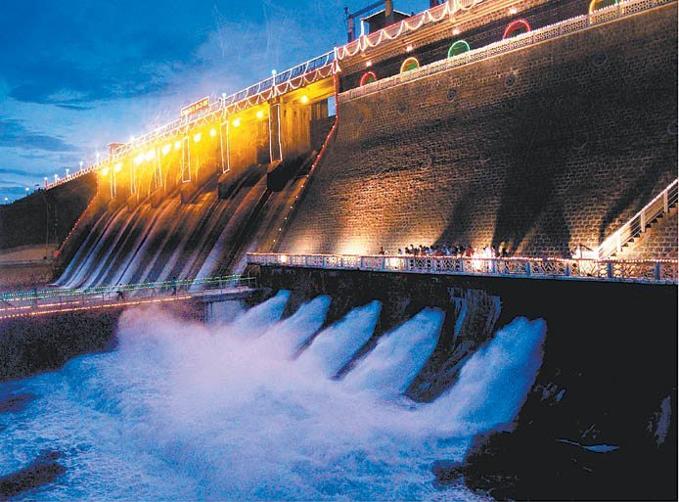
Real time –River Water Quality Monitoring System
TEAM ID : PNT2022TMID21316

Slide 2
Team Details
NAME | REG NO | IBM ROLL NO
ASHOKKUMAR P | 19C120 | 917719C120
GOKUL ANANTH M | 19C023 | 917719C023
GIRINATH S | 19C022 | 917719C022
GOPINATH E | 19C127 | 917719C127
SUGANTHAN A | 19C106 | 917719C106

Slide 3
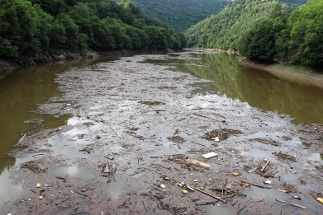
PROBLEM STATEMENT
“ Lack of Efficient Maintenance of River Water Quality “
Description:
Chemical toxic materials that alter the water level quality (pH, Temperature, Turbidity, BOD, COD)
Affects the source bodies that depend on river water such as agriculture, rural areas , etc.
Inefficient of usages which spoils all connecting water bodies

Slide 4
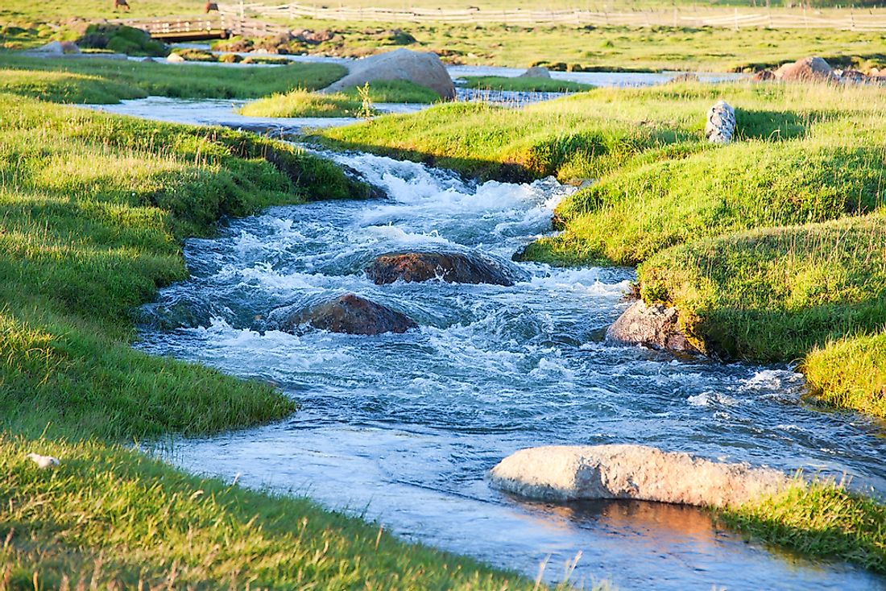

Objective & Motivation
To alert the end user for the prediction of contamination in the river water
To Predict the contaminated regions of that particular river bodies
To increase the growth of economic production

Slide 5





Proposed Solution
Collection of Required
Datasets
Prediction
Of attributes
Visualization
Of
Predicted Data
Data
Storage
Alert
End User

Slide 6
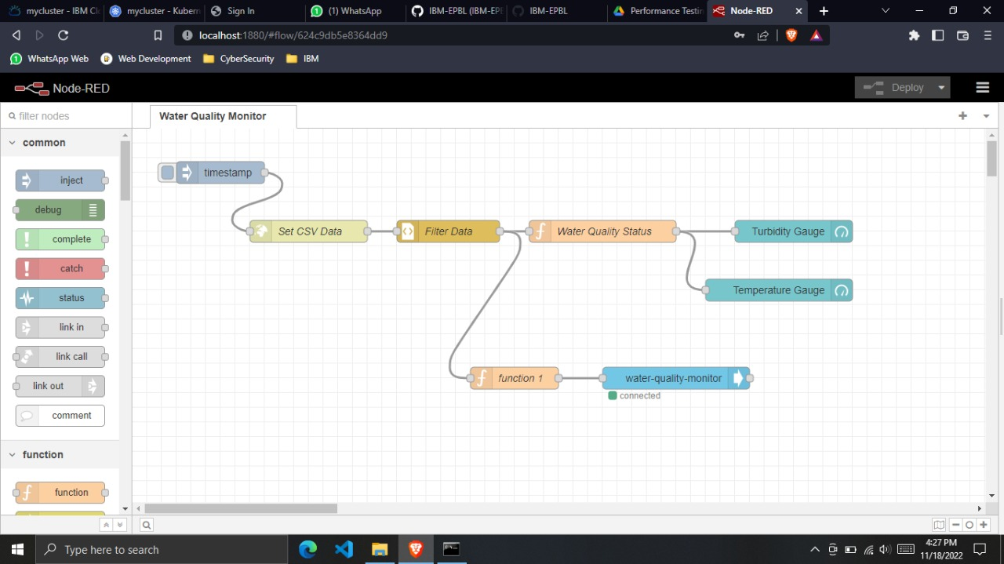
Node-Red
global.set("temperature",msg.payload.d.temperature);msg.payload=msg.payload.d.temperature;
global.set("Turb",msg.payload.d.Turbidity);msg.payload=msg.payload.d.Turbidity;
return msg;

Slide 7

Visualization of Data
Conclusions from the Visualized data inferred
The Factors that affect quality of water are:
pH value decreases with increase in temperature
turbidity increases with increase in temperature (vice versa)
pH increases with decrease in turbidity

Slide 8
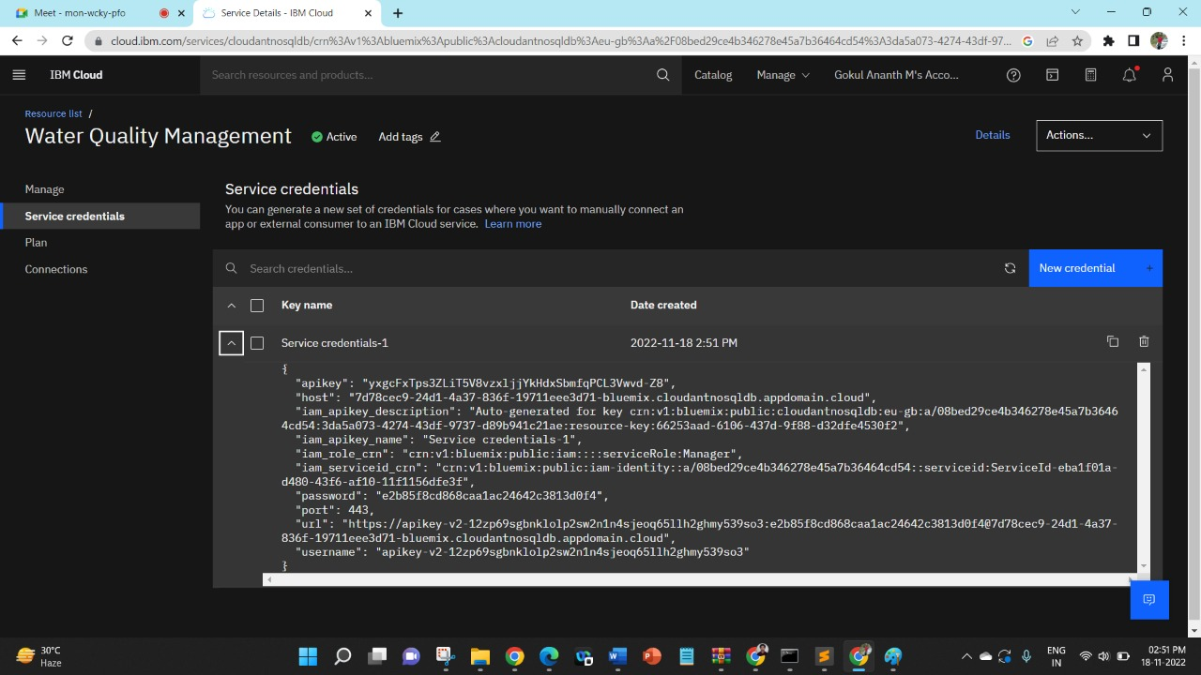
Data Storage

Slide 9
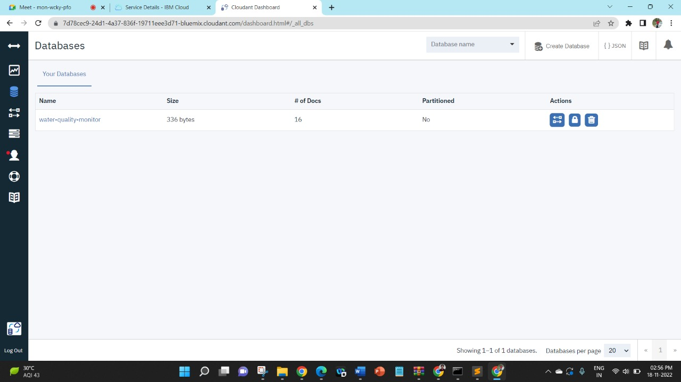
Data Storage

Slide 10
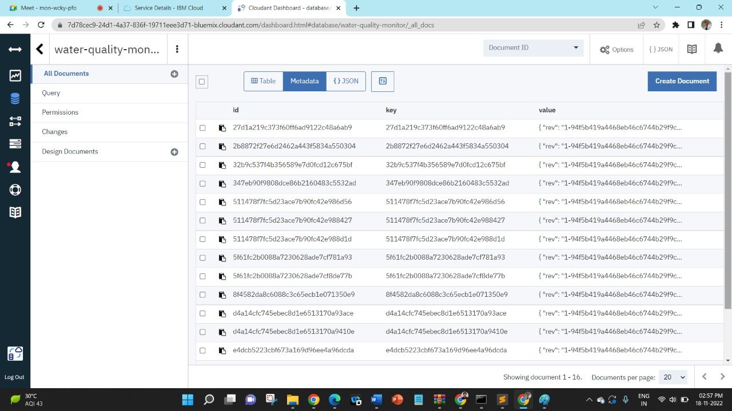
Data Storage

Slide 11
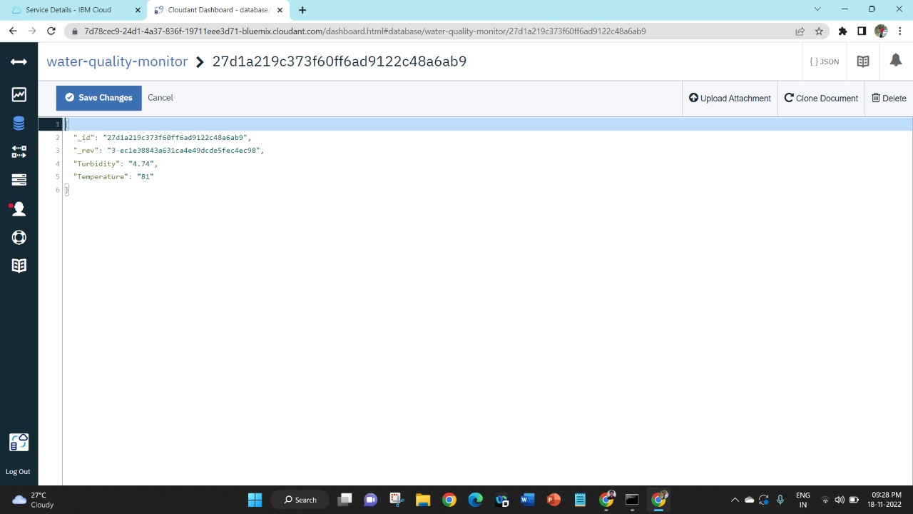
Data Storage

Slide 12
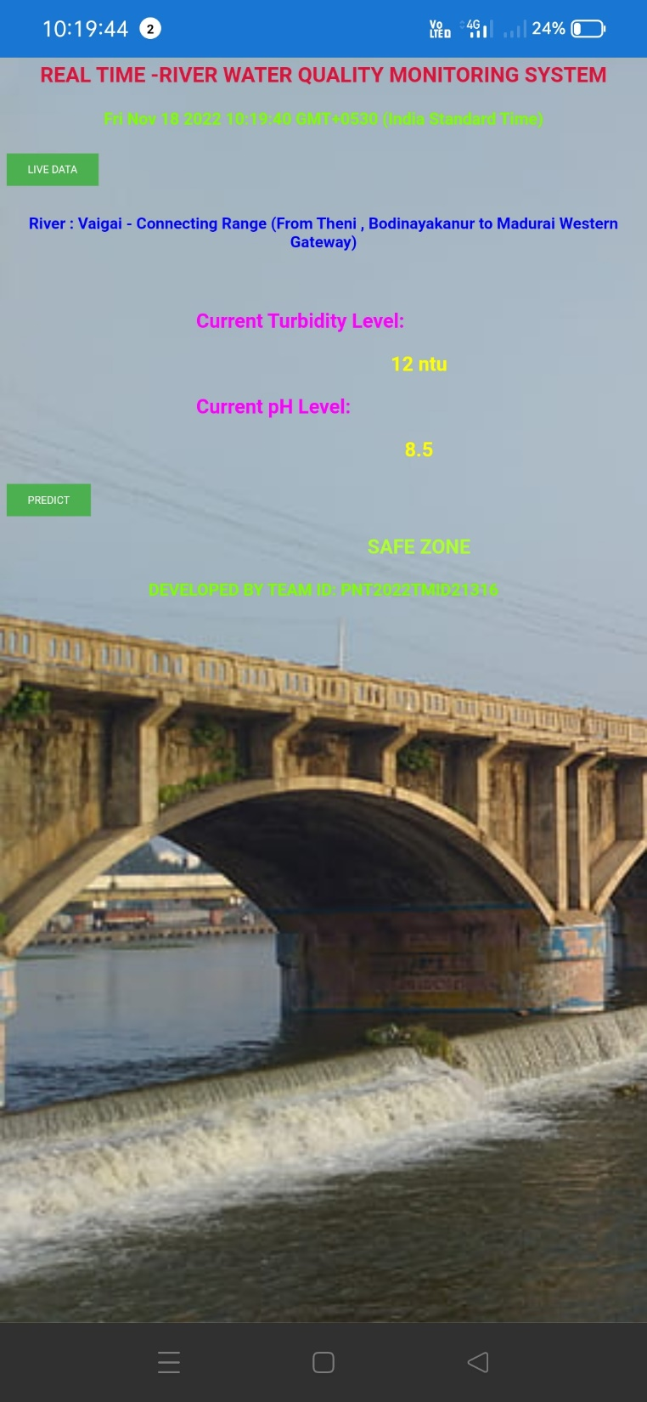
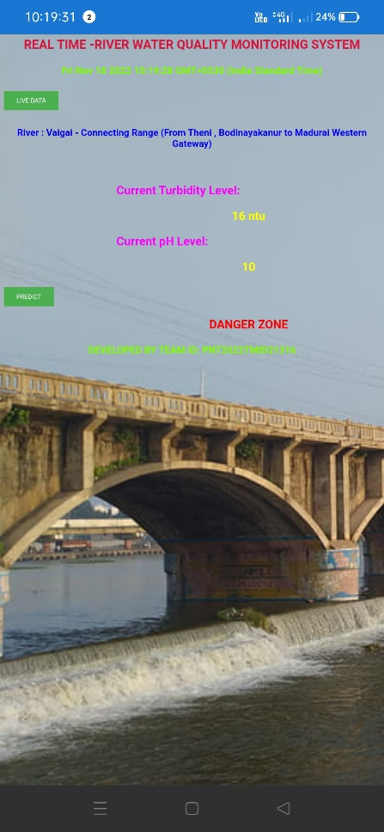

MOBILE APPLICATION
The Mobile application which alerts the end user depending on turbidity & pH value
Average pH range- 6.5 – 8.5
Average Turbidity level 5-15 ntu
msg.payload={“pH":global.get(“pH"),
"turb":global.get("Turb")};
return msg;

Slide 13
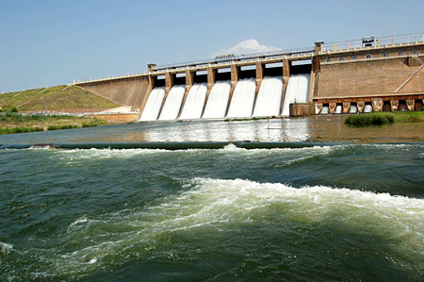
Advantages & Future Works
Contamination over the particular region could be known
Live access & monitor of water bodies from the remote location.
Future works
Monitoring of all river bodies in one single application
Prediction of Repeated Contaminated regions using previous data.

Slide 14
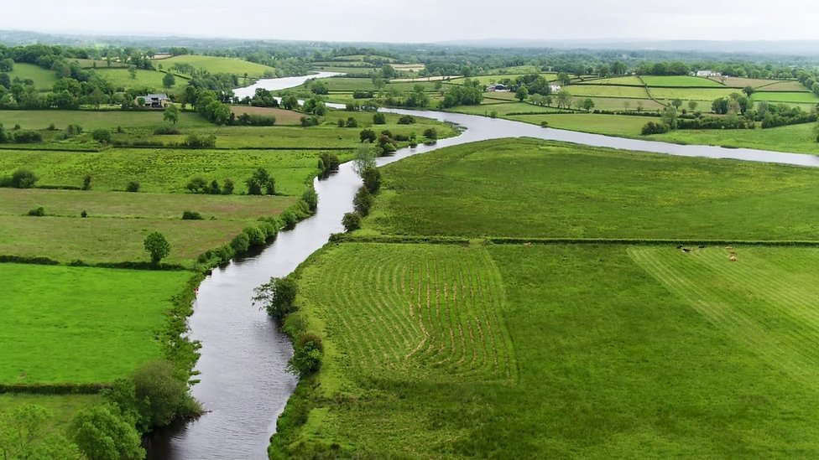
“Better the Quality Better the Future “

